Slide 1
Virtual-Memory Management
Benefits of Virtual Memory
Demand Paging
Principle of Working-set Model
Shared memory and Memory-mapped files
How to manage Kernel memory

Slide 2

LRU-Approximation Page Replacement
Very few computer systems provide hardware support for implementing LRU algorithm
Other page replacement algorithms are used
Reference bit may be provided with each entry in the page table
Initially all bits are 0
The bit is set if a page is used at least once since it was brought into memory
Order of use is not recorded
Information is used in many page-replacement algorithms that approximate LRU
Additional-Reference-Bits Algorithm
Additional ordering information can be recorded by keeping more bits

Slide 3
LRU-Approximation Page Replacement
A byte is kept for each entry in the page table in a shift register
Working of the scheme
Page with the lowest number is the LRU page
If there are zero additional bits
The algorithm is called second-chance page- replacement algorithm
Second-Chance Algorithm
Select the FIFO page and inspect the reference bit
If reference bit is 0, proceed with the replacement
If reference bit is 1, give this page a second chance

Slide 4
LRU-Approximation Page Replacement
A page is given second chance by clearing its reference bit and resetting the arrival time to the current time
Implement by using a circular queue
A pointer indicates which page should be replaced next
Second-chance replacement degenerates to FIFO if all bits are set
Enhanced Second-Chance Algorithm
Consider the reference bit and modify bit as an ordered pair
There are four possible classes
(0,0) Neither recently used nor modified
Best page to replace

Slide 5
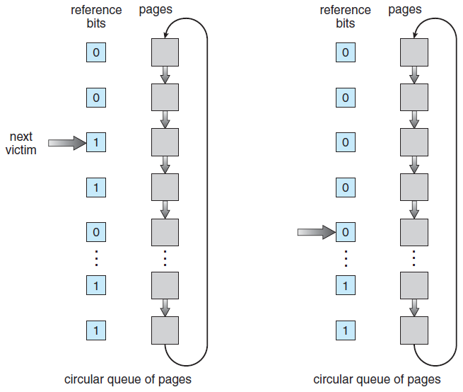
Second-Chance (clock) Page-Replacement Algorithm
Notes:
5

Slide 6
LRU-Approximation Page Replacement
(0,1) Not recently used but modified
Not a good choice for replacement
Page needs to be written to disk
(1,0) Recently used but clean
May be used again soon
(1,1) Recently used and modified
May be used again soon
Page has to be written to the disk
Replace the first page encountered in the lowest nonempty class
Circular queue may be scanned several times before the page is found
Modified pages are favored to reduce the I/O

Slide 7
Counting-Based page Replacement
Keep count of number of references to each page
Two schemes can be developed
Least frequently used (LFU) replacement algo.
Page with the smallest count is replaced
Problem
A page heavily used during initial phase but not used again will not be replaced
Shift the count right by one bit at regular intervals
Most frequently used (MFU) replacement algo.
Page with the smallest count was just brought in and has yet to be used
Implementation of both the above is expensive
They do not approximate OPT replacement well

Slide 8
Page-Buffering Algorithms
Optimizations are added to the replacement algorithms
Read the desired page first before writing the victim page
System keeps a pool of free frames
Maintain a list of modified pages
When paging device is idle, a modified page is written to the disk and M bit is reset
Keep a record of the contents of free frame list
Old page can be read directly from the free frames if needed
VAX/VMS uses this scheme with a FIFO replacement algorithm
UNIX uses this scheme with second-chance replacement algorithm

Slide 9
Applications and Page Replacement
Applications may use their own buffering mechanism
They perform badly if the OS-based scheme is also used
LRU may not work well for most of data warehousing applications
Some OS provide raw disk ability to application programs
Ability to use a disk partition as a large sequential array of logical blocks
I/O to this array is termed as raw I/O
Bypasses all the file-system services
Most applications perform better when regular file-system services are used

Slide 10
Allocation of Frames
How do we allocate the fixed amount of free memory among the processes?
Simplest case of frame allocation in a single- user system
Variants include maintaining a few free frames by the OS all the time
Minimum Number of Frames
OS must allocate at least a minimum number of frames to a process
Performance of the process is affected
Page fault rate is directly proportional to the number of frames allocated to a process

Slide 11
Allocation of Frames
A process should have enough frames to hold all the pages that a single instruction can reference
This is defined by the computer architecture
Move instruction of PDP-11, MVC of IBM 370
Worst-case scenario is in architectures that allow multiple levels of indirection
Maximum number of frames allocated to a process is defined by the available physical memory
Allocation Algorithms
Equal allocation
m frames are split among n processes
Give all processes equal share of m/n frames
A few frames are placed in the free buffer pool
Notes:
60 frames (4 free) – 2 processes may have 28 frames each

Slide 12
Frame Allocation Algorithms
Proportional allocation
Allocate the available physical memory to each process according to its size
Let size of virtual memory for p_{i} be s_{i} and define
S = ∑s_{i}
If the total available frames is m and a_{i} frames are allocated to p_{i} where
a_{i} = s_{i}/S x m, Each a_{i} is adjusted to be an integer
In both equal and proportional allocations, allocated frames vary according to the level of multiprogramming
High priority processes are treated equally with low-priority processes
A solution can be that a process is allocated frames as a combination of its size and priority
Notes:
62 frames –p1 of 10 pages, p2 of 127 pages: 10/137 x 62 = 4, 127/137 x 62 = 57

Slide 13
Global versus Local Allocation
Categories of page replacement algorithms
Global replacement
Allows a process to select a replacement frame from a set of all frames even if the frame is allocated to another process
Frames allocated to a process may increase
A process cannot control its own page-fault rate
Local replacement
Each process selects from its own allocated set of frames
Frames allocated to a process does not change
Global replacement generally results in greater system throughput
More commonly used method

Slide 14
Thrashing
If a process does not have ‘enough’ frames
It page-faults more frequently as compared to performing useful computation
A process is thrashing if it spends more time in paging than executing
A high paging activity
The process is suspended and swapped out freeing all allocated frames
Cause of Thrashing
Thrashing of a process gives rise to overall reduction in CPU utilization
Global replacement algorithm aggravates the situation even further
The effects of thrashing can be limited by using local replacement algorithm

Slide 15
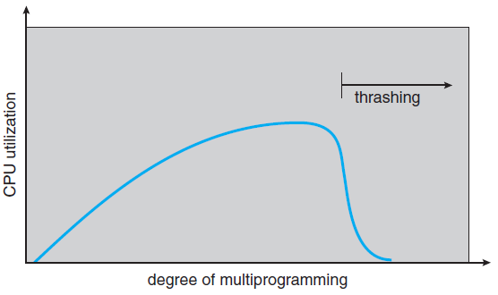
Thrashing
Notes:
15

Slide 16
Thrashing
Prevent thrashing by providing a process with as many frames as it needs
How is this number estimated?
Working-set strategy identifies the number of frames that a process is actually using
This approach defines the locality model of process execution
As a process executes, it moves from locality to locality
A locality is a set of pages that are actively used together
A program consists of several different localities that may overlap
All programs show locality in their memory reference patterns

Slide 17
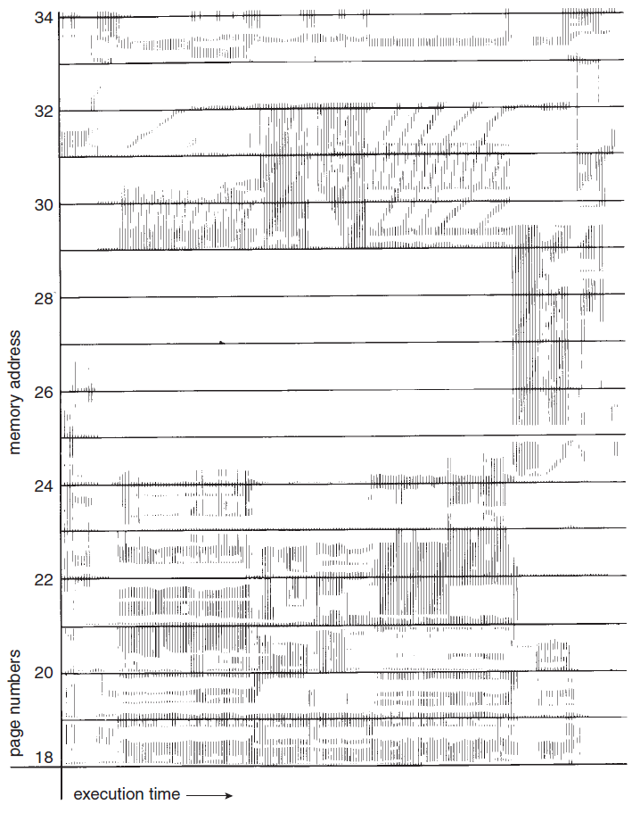
Locality In A Memoryreferen-ce Pattern
Notes:
17

Slide 18
Working-Set Model
Working-set model is based on the assumption of locality
A parameter Δ is used to define the working- set window
The set of pages in the most recent Δ page references is the working set
A page which is in active use would be a part of the working set
An approximation of program’s locality
The accuracy of working set depends on the selection of the parameter Δ
If we compute the working set size WSS_{i} for each process
D = ∑ WSS_{i}
where D is the total demand for frames

Slide 19
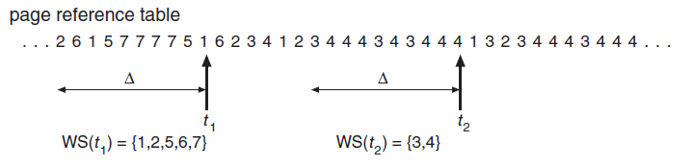
Working-set Model
Notes:
19

Slide 20
Working-Set Model
If D > m, thrashing will occur
Process monitoring is simple with selection of Δ
Suspension may take place to prevent thrashing
Optimum degree of multiprogramming
Working-set strategy prevents thrashing
It optimizes CPU utilization
Problem is to keep track of the working set
Working-set window is a moving window
Working-set model can be approximated by using a fixed-interval timer interrupt and a reference bit
This is not an accurate method
Increase the accuracy by increasing the number of history bits and the frequency of interrupts

Slide 21
Page-Fault Frequency
A more direct approach to control thrashing is to use page-fault frequency (PFF)
If the page fault rate is too high, the process needs more frames
If the page-fault rate is too low, the process may have too many frames
An upper and lower bound can be established on the desired page-fault rate
Measure and control the page-fault rate directly to prevent thrashing
A process is selected for suspension if the page-fault rate increases beyond the upper bound and no free frames are available

Slide 22
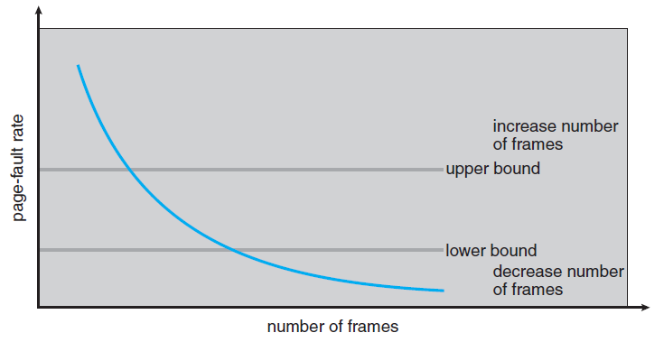
Page-Fault Frequency Scheme
Notes:
22

Slide 23
Memory-Mapped Files
File I/O can be treated as routine memory accesses
Approach is called memory-mapping a file
Part of the virtual address space is logically associated with the file
Map a disk block to a page in memory
A page-fault would read the corresponding block from disk into the page frame
Writes to the file block in memory is not transferred to disk immediately
Transferred to disk when the file is closed
Some OS update the disk contents periodically
System calls are provided in some OS for memory mapping of files
Others perform it automatically

Slide 24
Memory-Mapped Files
Multiple processes may be allowed to map the same file concurrently to allow the sharing of data
Write by one process modifies the data in virtual memory and is seen by other processes
This sharing can be implemented through page tables
System calls can be used to support copy-on-write functionality if desired
Sharing of memory-mapped file is similar to shared memory mapping
Shared-Memory in the Windows API
Reading assignment

Slide 25
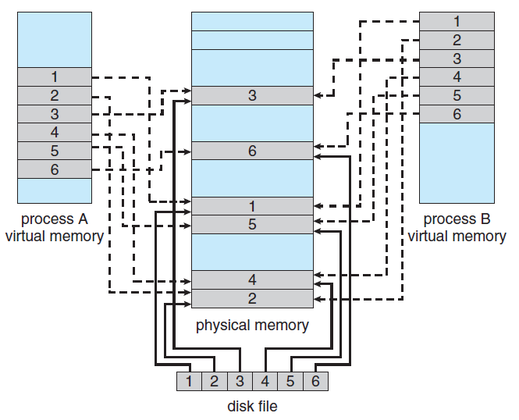
Memory Mapped Files
Notes:
25

Slide 26
Memory-Mapped I/O
I/O controllers consists of special registers to facilitate the transfer of data between system memory and I/O devices
Many computer architecture provide memory-mapped I/O to allow more convenient access to I/O devices
A range of memory addresses are set aside for I/O devices
Mapped to the device registers
All instructions can be used to operate on I/O devices
Programmed I/O can be performed between the CPU and I/O devices by the use of polling
Interrupt-driven I/O is based on interrupt generated for the transfer

Slide 27
Allocating Kernel Memory
Free memory assigned to kernel is contiguous in the physical address space
It is not subjected to paging
Reasons
Kernel must use memory conservatively minimizing wastage due to fragmentation
Certain hardware devices interact directly with the physical memory
May require memory residing in physically contiguous page
There are two strategies for managing free memory assigned to kernel processes

Slide 28
Allocating Kernel Memory
Buddy system
Allocates memory from a fixed-size segment consisting of physically contiguous pages
Power-of-2 allocator
Operation of buddy system
Advantage of buddy system : Coalescing technique where adjacent buddies can be combined to form larger segments
Disadvantage: Internal fragmentation within allocated segments
Slab Allocation
Another strategy for allocating memory to kernel
A slab is made up of one or more physically contiguous pages

Slide 29
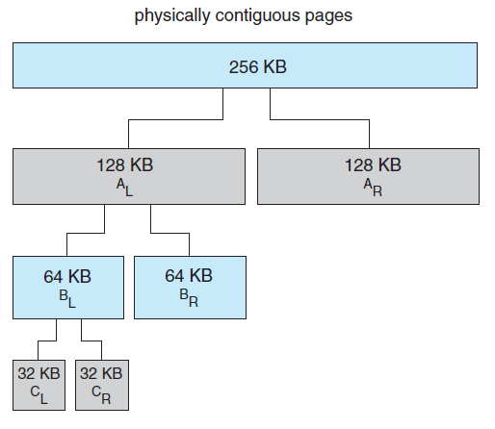
Buddy System Allocator
Notes:
29

Slide 30
Allocating Kernel Memory
A cache consists of one or more slabs
There is a single cache for each unique kernel data structure
Each cache is populated with objects that are instantiations of the kernel data structure the cache represents
The slab-allocation algorithm uses caches to store kernel objects
When a cache is created, a number of objects are allocated to the cache
The number of objects in the cache depends on the size of the associated slab
Free and used objects in a slab
Example of slab allocation for an object in Linux
Notes:
Process descriptors, file objects, semaphores, etc.

Slide 31
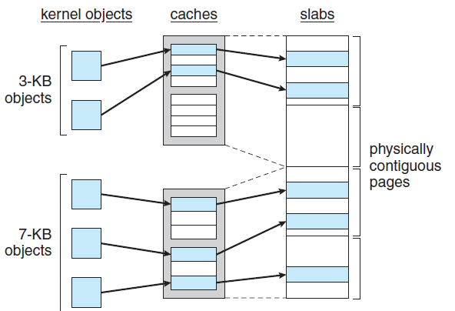
Slab Allocation
Notes:
31

Slide 32
Allocating Kernel Memory
A slab may be in one of three states in Linux
Full
All objects in the slab are marked as full
Empty
All objects in the slab are marked as free
Partial
The slab consists of both used and free objects
Benefits of slab allocator
No memory is wasted due to fragmentation
Allocator returns the exact amount of memory required to represent the object
Memory requests can be satisfied quickly
Slab allocator is used in Solaris and Linux

Slide 33
Allocating Kernel Memory
SLOB and SLUB allocators
Included in recent distributions of Linux
SLOB allocator (Simple List of Blocks)
Designed for systems with limited memory
Maintains three lists of objects
Small, medium and large
Uses first-fit policy to allocate memory from the list of blocks
SLUB allocator has replaced the default slab allocator from Linux V2.6.24
Reduces overhead required by the slab allocator
Provides better performance as the number of processors increase

Slide 34
Other Issues for Paging
Selection of a replacement algorithm and an allocation policy is central to paging systems
Other considerations are also important for performance
Prepaging
A strategy that is used to prevent a large number of initial page faults
Bring into memory all the pages that will be needed at one time
Systems using working-set model keep a list of pages in its working set
A process when suspended remembers its working set
Before restarting the process, its entire working set is brought into memory

Slide 35
Other Issues for Paging
Prepaging may offer advantage in some cases
Determine whether the cost of using prepaging is less than the cost of servicing the page faults
If s pages are prepaged and only a fraction α is used where 0 ≤ α ≤ 1, then
If α is close to 0, prepaging loses
If α is close to 1, prepaging wins
Page Size
One of the design choices made at the time of processor design is selection of a page size
What should be the size of a page?
There is no single best page size

Slide 36
Other Issues for Paging
Smaller page size
Advantages
Memory is more efficiently utilized because of less internal fragmentation
Smaller page size matches program locality more accurately
Total I/O is reduced
Better resolution is achieved allowing to isolate only the needed memory
Disadvantages
Smaller page size results in a larger page table
Frequency of I/O increases
Number of page fault increases

Slide 37
Other Issues for Paging
Advantages of larger page size
Results in smaller page table
I/O time is minimized
Larger page size minimizes page faults
Relationship between page size and sector size on the paging device is also important
Current trend in architecture is to have a relatively larger page size
TLB Reach
Hit ratio of a TLB increases with the increase in the number of entries in the TLB
TLB reach refers to the amount of memory accessible by the TLB
Number of entries multiplied by the page size

